Slide 1
Pt. 6 Interfaces and Self Assembly Lecture #18 Interfaces and amphiphiles
Self-assembly of soft matter:
Interface tension
Hydrophophilic vs. Hydrophobic
Amphiphiles and surfactants
Self Assembly in water: Micelles / microphase separation
Micelle geometry
Critical micelle concentration (CMC)
H
O
H
H
H
O
O
H
H
H
O
H

Slide 2
Interfaces between phases Liq/Liq phase separation (Ch. 3) implies interfaces Macroscopic:
Immiscible liquids: Interface is unfavourable, but moving wire by distance Δx creates more- hence, work ΔW to do
(Usually isothermal, so strictly, work is a H’holtz Free energy)
→ Force F on wire, F = ΔW/Δx
→ F ~ L, define interface tension γ
F = 2γL ←→ γ = F/2L = ΔW/2LΔx
Unit of γ: N/m or J/m²
is a property of the 2 liquids in contact
γ = γ(T)
Notes:
Be clear about what the factor of 2 is for. This is the capillary wetting of the wire, and you are essentially pulling the wire distance x out of the fluid. Obviously if x is too large the wire comes out of the fluid, but for small x this is not a big problem because you just create more fluid interface.

Slide 3
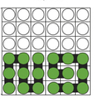
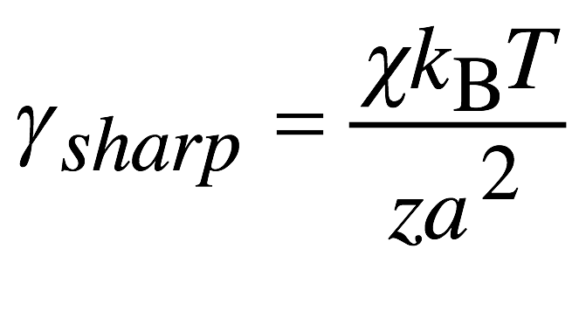
Molecular- level model of interface energy Back to the lattice model
Sharp
interface
Assume ‘sharp’ interface
Calculate interface energy ΔW per cell in lattice model P18.1
Assume cell = cube of side a, a = V₀^{1/3}, V₀: Volume of 1 molecule
LΔx = a² for one cell
Real γ < γ_{sharp},
interfaces are ‘blurred’
by Brownian motion
Interface tension is discussed
in SCM 3.2.1

Slide 4
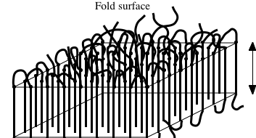
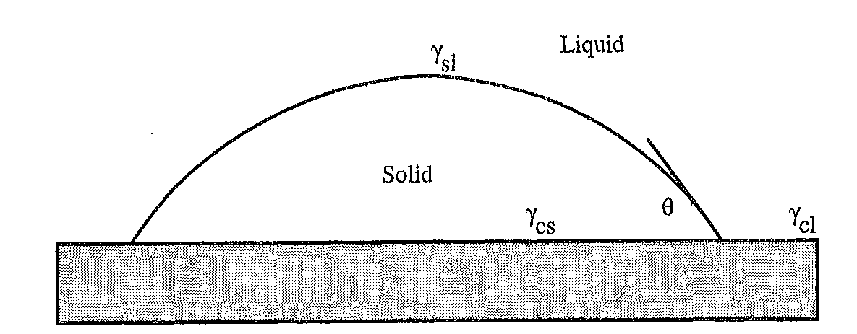
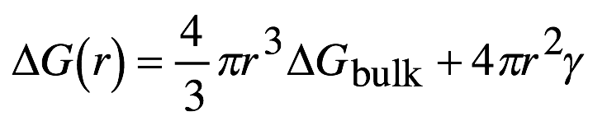
Flashback We already used interface tension = surface energy
ΔG = 2a²σ_{f} - La²ΔH_{m}ΔT/T_{m}(∞)
Polymer Xtal Lamellae
σ_{f} describes fold surface energy
Homogeneous crystal Nucleation
describes melt/crystallite surface energy
Heterogeneous
nucleation

Slide 5
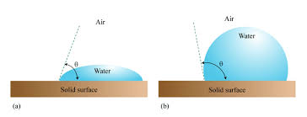
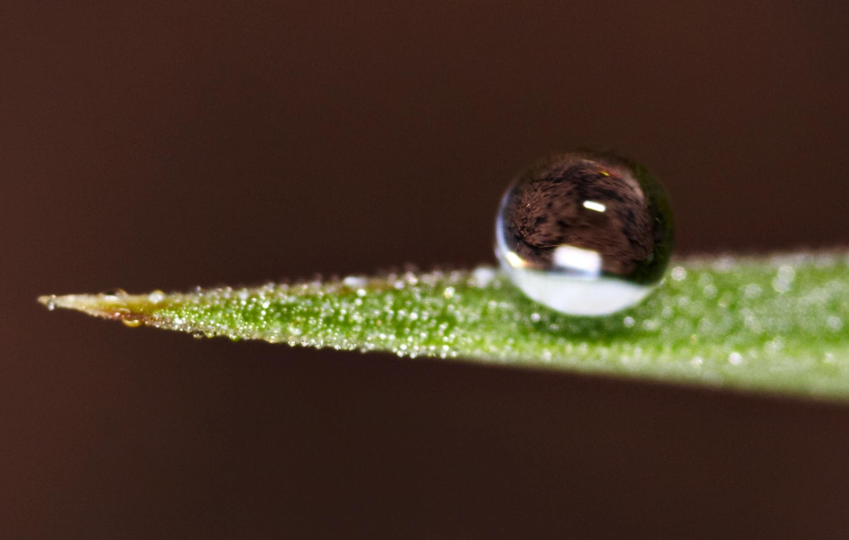
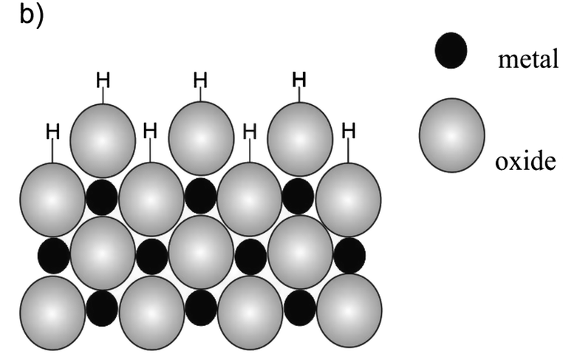
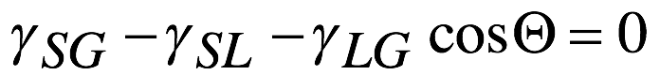
Hydrophilic vs. Hydrophobic surfaces
‘Hydrophilic’ surface:
Good wetting with water
Small γ_{SL}, small ‘contact angle’
e.g. solid oxides
‘Hydrophobic’ surface:
Poor wetting with water
Large γ_{SL}, large ‘contact angle’
e.g. waxed surface
Contact angle given by interface tensions γ (Solid/Liquid/Gas)
Young eqn.:
Reason @ molecular level:
H- bonding (h’philic) vs.
Hydrophobic interaction (odd)

Slide 6
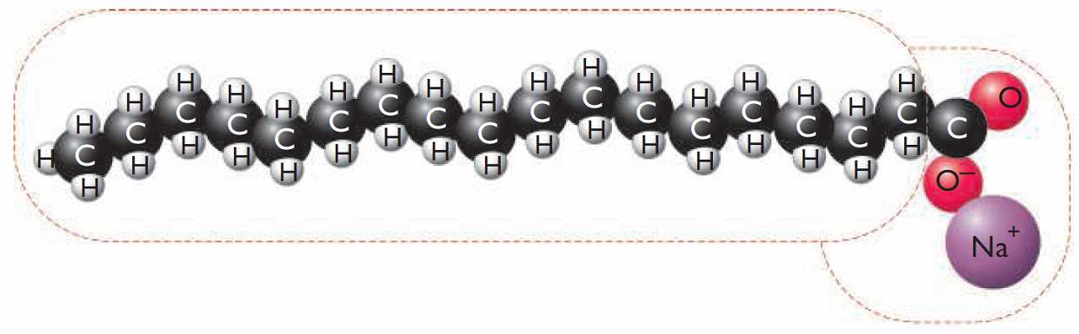
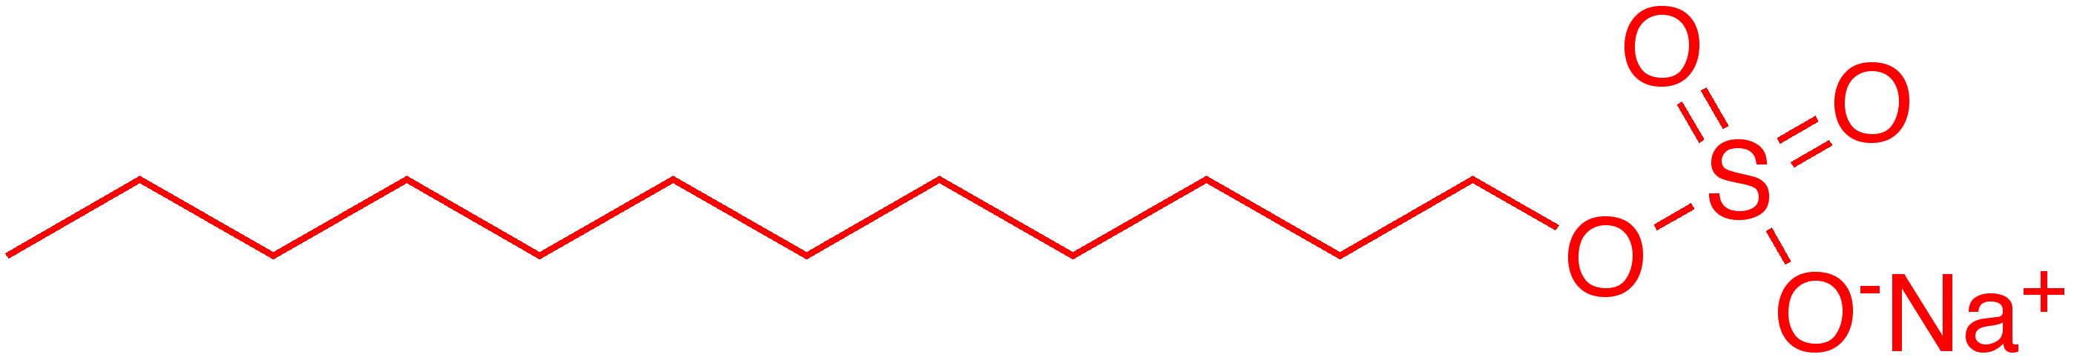
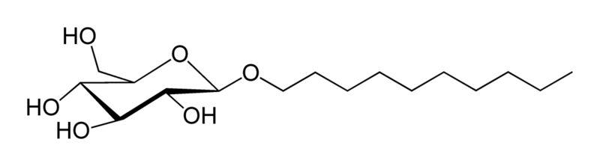
Amphiphiles
Molecules which have hydrophobic and hydrophilic parts
Polar or ionic hydrophilic ‘head’ (Anionic, cationic, or non-ionic)
Chemically bonded to hydrophobic alkyl chain ‘tail’
Sodium stearat: Soap (anionic)
Sodium dodecyl
sulfonate (SDS):
Laundry powder
(anionic)
Dodecyl glucoside:
Shampoo (non- ionic)
Notes:
Worth asking about surfactants - not just in detergents, but also in the extracellular matrix etc. octanol and SDS shown here. Note octanol is not miscible in water, but methanol is. It is worth discussing the effect of the alkyl chain in miscibility with water. 1-propanol is pretty miscible with water, but n-butanol is only partially miscible with two phases; one containing 32% w/w water and the other (less dense) containing 5% w/w n-butanol.

Slide 7
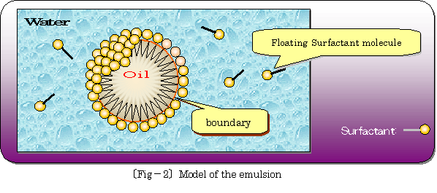
Amphiphile as detergent
3- component mix: Water / ‘oil’ (hydrophobic liquid) / amphiphile
Amphiphile accumulates at oil/water interface:
Hydrophobic end in oil, hydrophilic head facing water
→ Reduced interface energy/surface tension
→ Allows formation of more surface
→ stable ‘Emulsion’ of small oil droplets

Slide 8
Amphiphile as surfactant
2- component mix: Water / amphiphile ‘surfactant’
Low conc.: Amphiphile dissolves, some accumulate
at surface → Graded water/air transition,
reduced surface tension
Increasing conc.: Surface tension decreases
‘Excess’ conc.: Amphiphile ‘saturates’
forms ‘droplets’ w/out oil:
‘Micelles’, ‘microphase separation’: Equilibrium
above ‘critical micelle concentration’ (CMC)
(Wikipedia)
G Pourceau et al,
Molecules 2016, 21(10), 1301

Slide 9
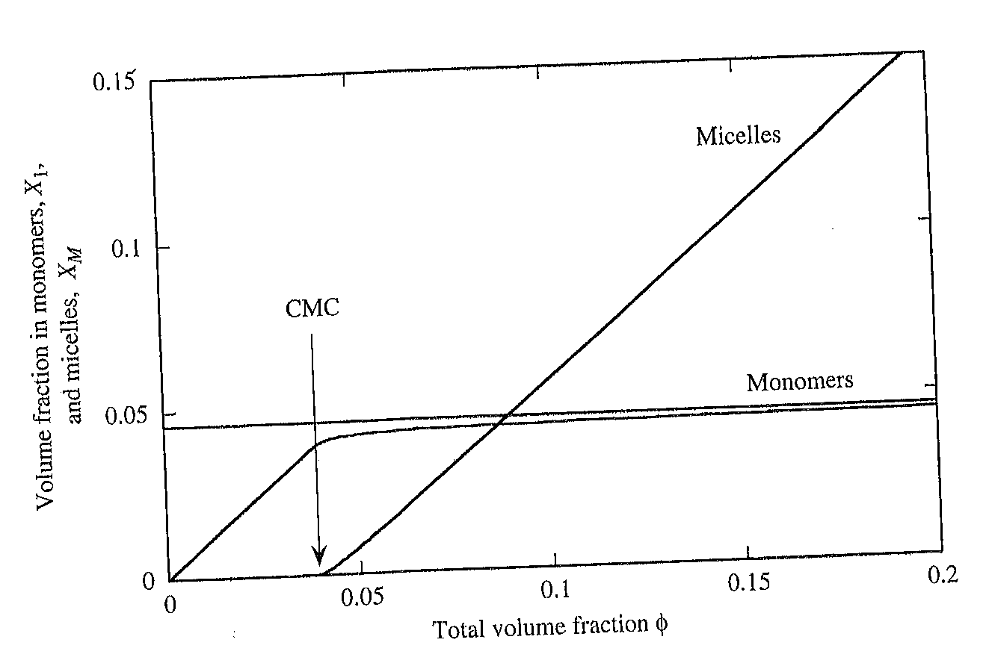
Critical micelle concentration (CMC)
e.g. SDS, 20 ºC:
CMC c = 8.2 mM
(note c vs. Φ) P18.2
CMC = CMC(T)
Minimum T needed
for some amphiphiles
(‘Krafft Temperature’)
As you add amphiphile to water, first it all dissolves/goes to surface.
Micelles only appear above CMC.
Above CMC, all additional amphiphile then goes into micelles
Similar to liquid/liquid phase separation:
Small fraction Φ << 1 of ’immiscible’ liquid does dissolve / mix

Slide 10
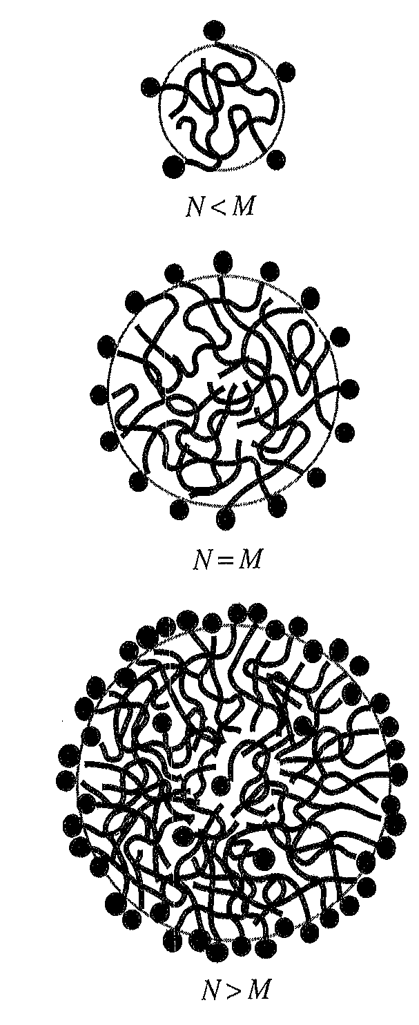
(Spherical) Micelles: Optimum N = M
E_{N} (energy/molecule) has a minimum at N = M
Micelle size M favoured over both
- isolated molecules (N = 1, solution)
- ‘macro’ phase separation (N → ∞)
(e.g. water/oil)
e.g. SDS: M = 62
Different for cylindrical micelles
- ‘infinitely’ long gives lowest E_{N}

Slide 11
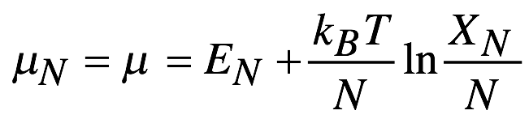
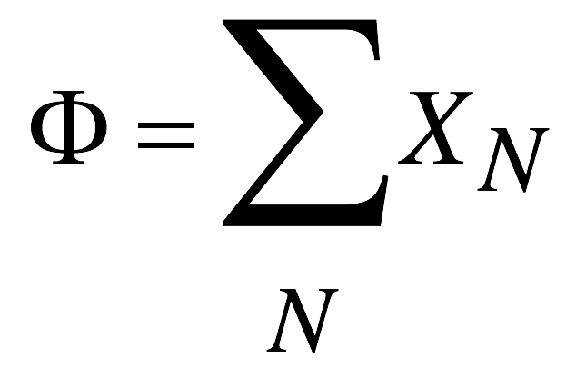
CMC for spherical micelles - a simple theory -
X_{N}: Volume fraction of molecules in N- size micelles (isolated / dissolved molecule: N = 1)
Total vol. fraction
Equilibrium condition: Chemical potential equal across all micelles

Slide 12
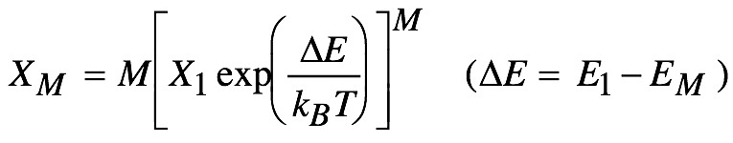
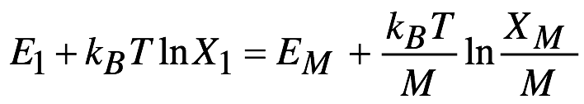
CMC for spherical micelles - a simple theory -
Assume only two fractions: Isolated/dissolved amphiphile (N=1), X₁,
or amphiphile in optimum sized (M) micelle, X_{M}
(Fair for spherical, not for cylindrical)
➔ P18.3
If X₁ < exp(-ΔE/k_{B}T): X_{M} << X₁, almost all molecules are dissolved,
Amphiphile volume fraction Φ ≈ X₁
Critical micelle concentration (CMC) X₁ = Φ_{c} = exp(-ΔE/k_{B}T)
(Note the misnomer- Φ_{c} is a volume fraction, not a concentration!)

Slide 13
Different micelle shapes: Not just spheres
Hydrophobic-Hydrophilic molecule
Bilayers
Cylindrical (Wormlike) Micelles
Spherical Micelles
Slide courtesy of M R Tomlinson

Slide 14
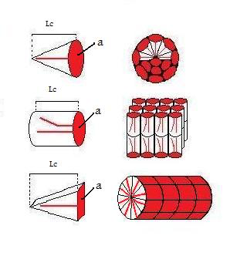
Cylindrical/spherical micelles? Bilayers?
Amphiphile geometry:
Maximum/stretched length of alkyl chain, l_{c}
Area of head group a₀
Hydrophobic (hydrocarbon) volume v (shaded)
Note: a₀ is not purely geometric for charged head group
v
l_{c}
a₀
Define ‘Micelle packing parameter’
p = v/a₀l_{c} (dimensionless)
Small p → spheres
Medium p → cylinders
Large p → Bilayers

Slide 15
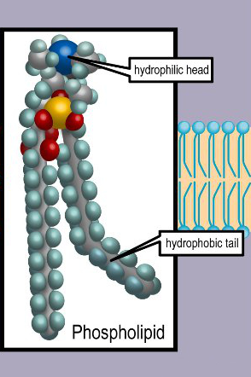
Quantitative micelle geometry
Sphere of M molecules: Mv = V = 4πr³/3; Ma₀= A = 4πr²
Ratio V/A = v/a₀ = r/3 < l_{c}/3 ➔ v/a₀l_{c} = p < ¹/₃
Cylinder of M molecules: V = πr²l = Mv; A = 2πrl = Ma₀
Ratio V/A = v/a₀ = r/2 < l_{c}/2 ➔ v/a₀l_{c} = p < ½
p < ¹/₃ : Spherical micelles; ¹/₃ < p < ½: Cylindrical micelles
p > ½: Bilayers
Bilayers: E.g. Phospholipids
2 h’phobic tails per h’philic head
Large v ➔ Bilayers
Biological membranes
Microphase separation
←→ ‘Self assembly’

Slide 16
Summary: Lecture #18 Interfaces and amphiphiles
Interfaces btwn immiscible liquids cost energy, quantified by γ
Important example: Water/solid interfaces, ‘hydrophilic’ vs ‘hydrophobic’
Amphiphiles are molecules with hydrophobic and hydrophilic units, act as detergents and surfactants
Amphiphiles in water can micro- phase separate into micelles
Critical Micelle Concentration (CMC)
Spherical/cylindrical/bilayer micelles
←→Amphiphile geometry (p)
The material contained within this lecture can be found in SCM Ch. 3.2, and Ch. 9 from 9.1 to 9.2.2

Slide 17
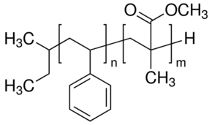
Lecture #19 Block copolymer self assembly
Another micro- phase separation
e.g. PS-b-PMMA diblock copolymer
PS and PMMA are incompatible
→ Phase separation
But can’t macro- phase separate
Because the blocks are chemically bonded
Both atactic ➔ don’t Xtallise

Slide 18
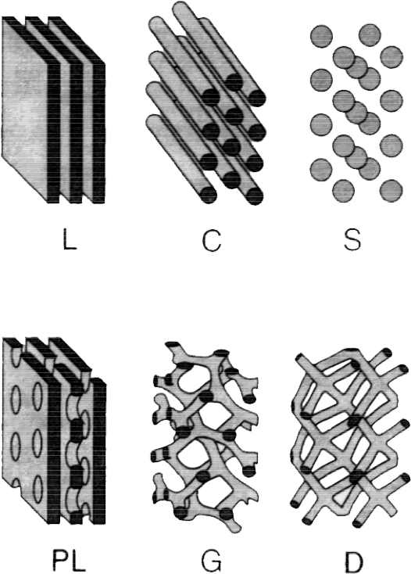
(Di)Block copolymers
Block copolymers form varied morphologies
Require immiscible blocks, χ > 2/N
Morphology depends on the ratio f, f = n / (n + m)
Simplest: Lamellar (L)
similar block sizes (f ≈ ½)
(Do not confuse with Xtal lamellae!)
Another micro- phase separation
Leads to regular large- scale structures
Without crystallinity
from SCM

Slide 19
Diblock copolymer morphologies Phase diagram
W van Zoelen, G ten Brinke, Soft Matter 5, 1568 (2009)
N = n+m: Total No. of repeat units in chain
f = n/N: ratio of block lengths (f = ½ means n = m = N/2)

Slide 20
Lamellar morphology
Here the two blocks are of similar size, n ≈ m (f ≈ ½)
Phase separation even for small positive χ
‘Lamellae’ – but amorphous - not to be confused with crystalline lamellae
Scaling of lamella thickness d with N? d ~ N^{b} (Note: N ≈ 2n, so same scaling)
d

Slide 21
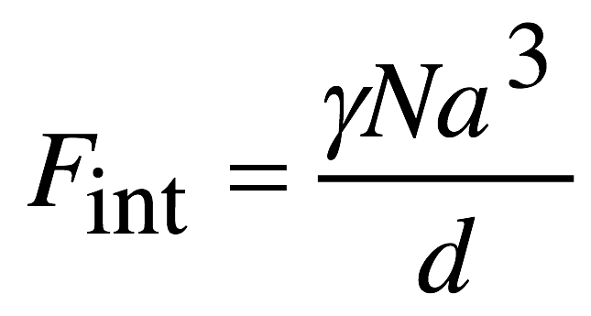
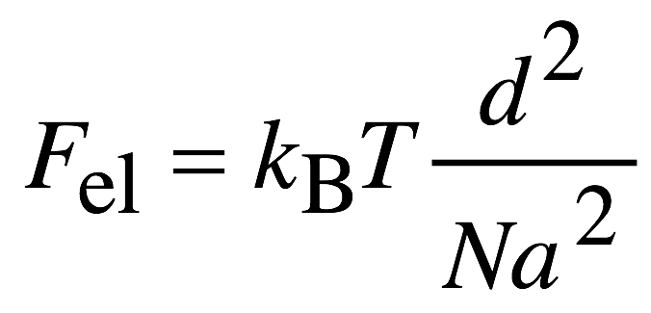
Block copolymer lamellae: d = ?
Lamella interfaces are unfavourable
The interfacial free energy per chain is
The interfacial energy per unit volume scales as γ /d
There are 1/(Na³) chains in unit volume
F_{int} minimised by large d ➔ stretch chains
But stretching reduces entropy, gives rubber- elastic energy
Minimise the total free energy, F = F_{el} + F_{int} , w.r.t. d P19.1
Scaling law for lamella thickness: d ~ N^{2/3}
Surface tension γ stretches coils. Compare to R ~ N^{1/2} in homopolymer melt; R ~ N^{3/5} in good solvent

Slide 22
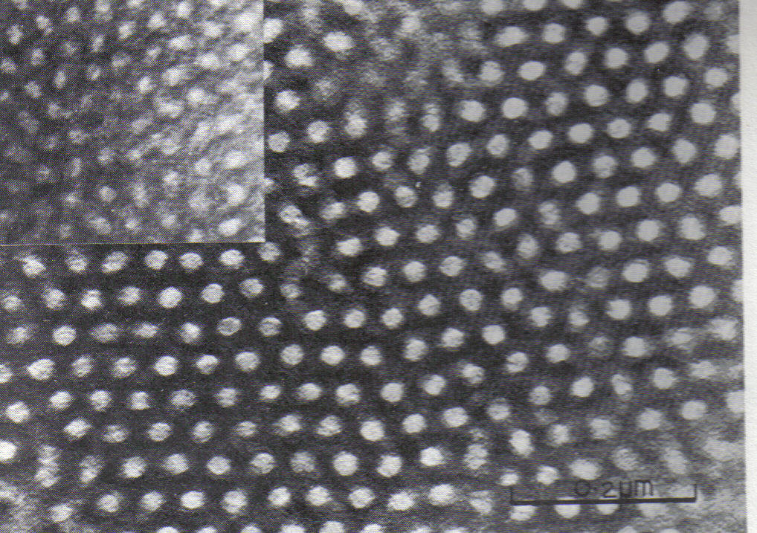
SBS (‘Kraton’) synthetic rubber
Poly (styrene-butadiene-styrene) (SBS) triblock copolymer
Polystyrene blocks: T_{g} ≈ 100 ºC
Polybutadiene blocks: T_{g} ≈ -90 ºC
At ~ 170 ºC: Process from viscous
melt (thermoplastic).
At ambient: Polybutadiene
‘physically crosslinked’
Rubber aka Elastomer
‘Thermoplastic elastomer’
Physics + Chemistry
(TEM, Styrene blocks light)
Hexagonal nanostructure

Slide 23
Summary: Lecture #19 Block copolymer self assembly
Variety of regular structures through microphase separation
Phase diagram for diblock copolymer structures
Lamellae: Minimising interfaces stretches block coils, d ~ N^{2/3}
Microphase separated SBS: Thermoplastic elastomer
The material contained within this lecture can be found in SCM 9.3.2

Slide 24
Recurring themes summary
Scaling laws: A polymer size proportional to number of repeat units to a power
Globule (collapsed coil), R ~ N^{1/3}; Melt/Θ solvent: R ~ N^{1/2};
Good solvent: R ~ N^{3/5}; Block copolymer lamellae: d ~ N^{2/3}
Mean field theories: Approximate treatment of statistical physics problems
Self- avoiding random walk (SARW) R scaling, lattice theory of liquid/liquid mixing or phase separation, nematic LC ordering
Microphase separation / self assembly: Parts of molecules try separate from each other, but are tied together by chemical bonds
Smectic A LC, amphiphile micelles, block copolymers

